Slide 1
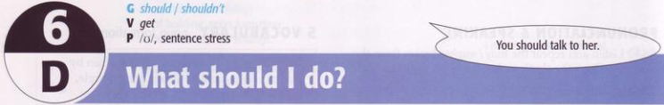
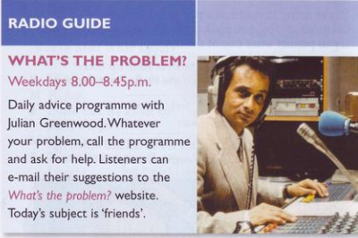
1. Listening & Reading
Read the extract from a TV and radio guide.
1. What kind of programme is it?
It’s an advice programme.
2. Why do people call the programme?
To explain a problem they have and ask
for help/advice.
3. Would you call a programme like this?

Slide 2

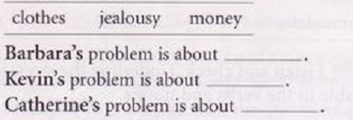
b. Listen to 3 people phoning What’s the Problem? and complete the sentences with one word.
money
jealousy
clothes

Slide 3
c. Now listen again. What exactly are their prpblems? Compare what you understood with your partner.
She has a friend who’s very mean. When he goes out with her and her friends he never pays, but he’s not poor.
His best friend flirts with his girlfriend.
Her flatmate always borrow her things without telling her, CDs, books, clothes, etc.

Slide 4
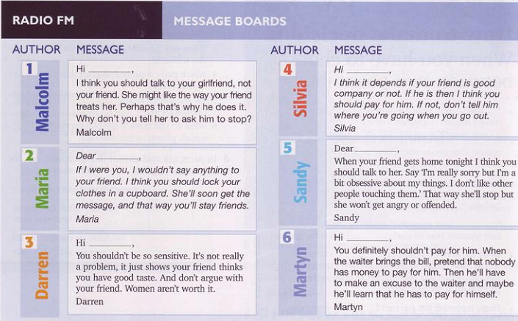
d. Match 2 e-mails to each problem. Write Barbara, Kevin, or Catherine.
Kevin
Barbara
Catherine
Catherine
Kevin
Barbara

Slide 5
2. Grammar: Should/ shouldn’t
Examples:
You should get up early.
You shouldn’t go to bed late.
I think you should change your job.
Forms:
Should
Should not/ Shouldn’t
S +
+ V(inf.)

Slide 6
Uses:
We use should/ shouldn’t to give somebody advice or say what you think is the right thing to do.
Ex: You should cut your hair = I think it would be a good idea.
Should/ shouldn’t is the same for all persons.
You can also use ought to/ought not to instead of should/ shouldn’t .
Ex: You should change your job. = You ought to change your job.

Slide 7
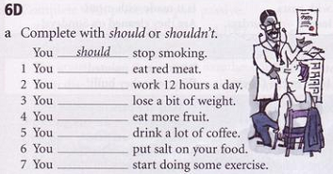
Excercises:
a. Complete with should/ shouldn’t.
shouldn’t
shouldn’t
should
should
shouldn’t
shouldn’t
should

Slide 8
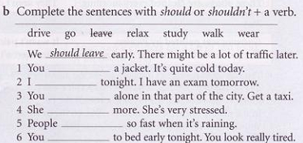
b. Complete the sentences with should or shouldn’t + a verb.
should wear
should study
shouldn’t walk
should relax
shouldn’t drive
should go

Slide 9
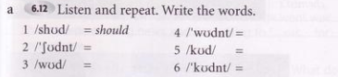
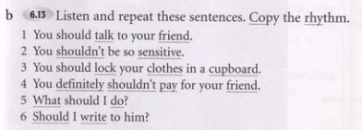
3. Pronunciation & speaking /ʊ/
wouldnt
shouldn’t
could
would
couldn’t

Slide 10
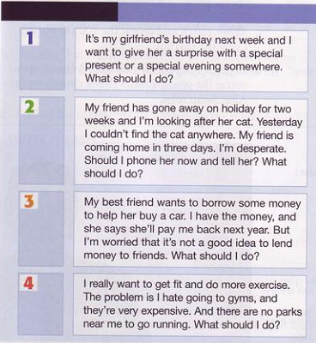
4. Writing & Speaking
Choose one of the problem and write a short note giving advice.

Slide 11
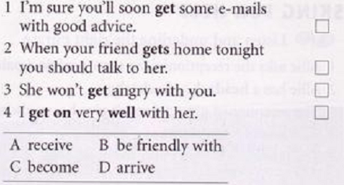
5. Vocabulary: get
Look at these sentences from 1. Match the examples of get with meanings A-D.
A
D
C
B

Slide 12
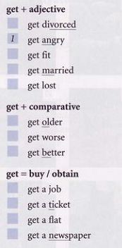
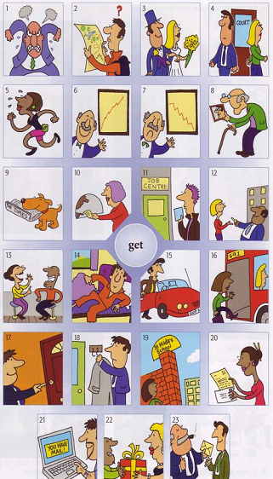
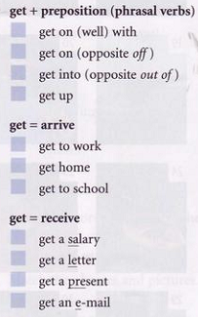
Match the phrases and the pictures.
4
5
3
2
8
7
6
11
10
12
9
13
16
15
14
18
17
19
23
20
22
21

Slide 13
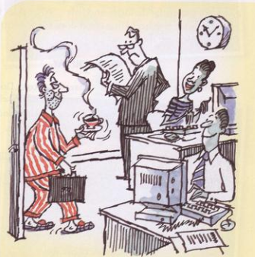
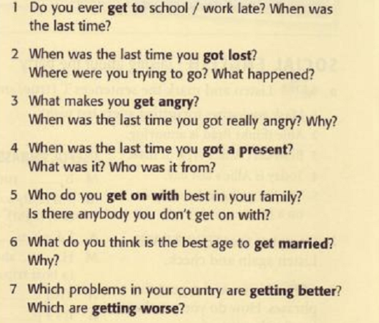
Do the get questionnaire.

Slide 14
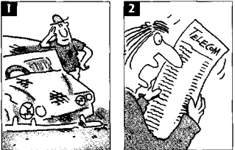
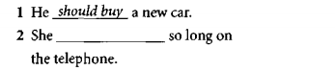
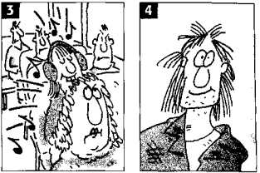
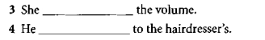
Exercises

Slide 15
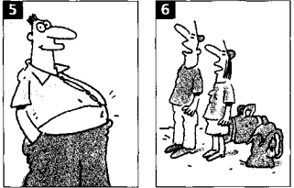
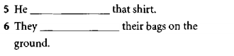
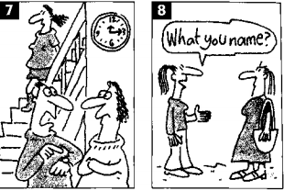
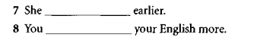

Slide 16
